Slide 1


E-commerce
business. technology. society.

Slide 2
Chapter 2
E-commerce Business Models and Concepts

Slide 3
E-commerce Business Models
Business model
Set of planned activities designed to result in a profit in a marketplace
Business plan
Describes a firm’s business model
E-commerce business model
Uses/leverages unique qualities of Internet and Web

Slide 4
8 Key Elements of a Business Model
Value proposition
Revenue model
Market opportunity
Competitive environment
Competitive advantage
Market strategy
Organizational development
Management team

Slide 5
1. Value Proposition
Why should the customer buy from you?
Successful e-commerce value propositions:
Personalization/customization (consists of tailoring a service or a product to accommodate specific individuals, sometimes tied to groups or segments of individuals)
Reduction of product search, price discovery costs
Facilitation of transactions by managing product delivery

Slide 6
Price discovery is the general process used in determining spot prices. These prices are dependent upon market conditions affecting supply and demand. For example, if the demand for a particular commodity is higher than its supply, the price will typically increase (and vice versa).

Slide 7
2. Revenue Model
How will the firm earn revenue, generate profits, and produce a superior return on invested capital?
Major types:
Advertising revenue model
Subscription revenue model
Transaction fee revenue model
Sales revenue model
Affiliate revenue model

Slide 8
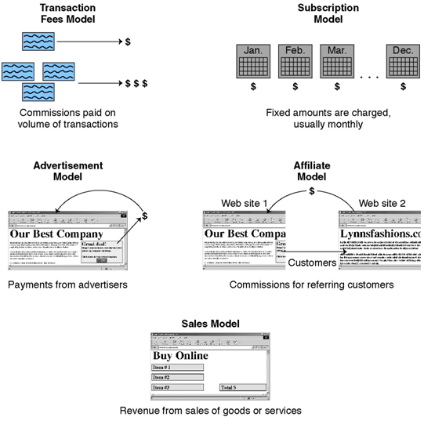

Slide 9
3. Market Opportunity
What marketspace do you intend to serve and what is its size?
Marketspace: Area of actual or potential commercial value in which company intends to operate
Realistic market opportunity: Defined by revenue potential in each of market niches in which company hopes to compete
Market opportunity typically divided into smaller niches

Slide 10
4. Competitive Environment
Who else occupies your intended marketspace?
Other companies selling similar products in the same marketspace
Includes both direct and indirect competitors
Influenced by:
Number and size of active competitors
Each competitor’s market share
Competitors’ profitability
Competitors’ pricing

Slide 11
5. Competitive Advantage
What special advantages does your firm bring to the marketspace?
Achieved when firm produces superior product or can bring product to market at lower price than competitors
Important concepts:
Asymmetries
First-mover advantage
Unfair competitive advantage
Leverage

Slide 12
6. Market Strategy
How do you plan to promote your products or services to attract your target audience?
Details how a company intends to enter market and attract customers
Best business concepts will fail if not properly marketed to potential customers

Slide 13
7. Organizational Development
What types of organizational structures within the firm are necessary to carry out the business plan?
Describes how firm will organize work
Typically divided into functional departments
Hiring moves from generalists to specialists as company grows

Slide 14
8. Management Team
What kinds of experiences and background are important for the company’s leaders to have?
Employees are responsible for making the business model work
Strong management team gives instant credibility to outside investors
Strong management team may not be able to salvage a weak business model, but should be able to change the model and redefine the business as it becomes necessary

Slide 15
Categorizing E-commerce Business Models
No one correct way
We categorize business models according to:
E-commerce sector (B2C, B2B, C2C)
Type of e-commerce technology; i.e., m-commerce
Similar business models appear in more than one sector
Some companies use multiple business models; e.g., eBay

Slide 16
B2C Business Models: Portal
Search plus an integrated package of content and services
Revenue models:
Advertising, subscription fees, transaction fees
Variations:
Horizontal/General
Vertical/Specialized (Vortal)
Pure Search

Slide 17
B2C Models: E-tailer
Online version of traditional retailer
Revenue model: Sales
Variations:
Virtual merchant
Bricks-and-clicks
Catalog merchant
Manufacturer-direct
Low barriers to entry

Slide 18
B2C Models: Content Provider
Digital content on the Web
News, music, video
Revenue models:
Subscription; pay per download (micropayment); advertising; affiliate referral fees
Variations:
Content owners
Syndication
Web aggregators

Slide 19
B2C Models: Transaction Broker
Process online transactions for consumers
Primary value proposition—saving time and money
Revenue model:
Transaction fees
Industries using this model:
Financial services
Travel services
Job placement services

Slide 20
B2C Models: Market Creator
Uses Internet technology to create markets that bring buyers and sellers together
Examples:
Priceline
eBay
Revenue model: Transaction fees

Slide 21
B2C Models: Service Provider
Online services
e.g., Google: Google Maps, Google Docs, and so on
Value proposition
Valuable, convenient, time-saving, low-cost alternatives to traditional service providers
Revenue models:
Sales of services, subscription fees, advertising, sales of marketing data

Slide 22
B2C Models: Community Provider
Provides online environment (social network) where people with similar interests can transact, share content, and communicate
E.g., Facebook, MySpace, LinkedIn
Revenue models:
Advertising fees, subscription fees, sales revenues, transaction fees, affiliate fees

Slide 23
B2B Business Models
Net marketplaces
E-distributor
E-procurement
Exchange
Industry consortium( Groups formed from other comp.)
Private industrial network
Single firm
Industry-wide

Slide 24
B2B Models: E-distributor
Supplies products and services directly to individual businesses
Owned by one company seeking to serve many customers
Revenue model: Sales of goods
Example:grainger.com

Slide 25
B2B Models: E-procurement
Creates and sells access to digital electronic markets
Includes B2B service providers, application service providers (ASPs)i.e. http://www.industrybuying.com/
Revenue model:
Transaction fees, usage fees, annual licensing fees
Example: SAP-Ariba
i.e. https://www.ariba.com/solutions/solutions-overview/procurement

Slide 26
B2B Models: Exchanges
Electronic digital marketplace where suppliers and purchasers conduct transactions
Usually owned by independent firms whose business is making a market
Usually serve a single vertical industry
Revenue model: Transaction, commission fees
Create powerful competition between suppliers
Number has dropped dramatically

Slide 27
B2B Models: Industry Consortia
Industry-owned vertical marketplaces that serve specific industries (e.g., automobile, chemical.)
More successful than exchanges
Sponsored by powerful industry players
Strengthen traditional purchasing behavior
Example: Exostar

Slide 28
Private Industrial Networks
Designed to coordinate flow of communication among firms engaged in business together.
Electronic data interchange (EDI)
Single firm networks
Most common form
Example: Wal-Mart’s network for suppliers
Industry-wide networks
Often evolve out of industry associations
Example: Agentrics

Slide 29
Business Models in Emerging E-commerce Areas
Consumer-to-consumer (C2C)
Examples:Ebay.com Half.com
Peer-to-peer (P2P) a decentralized platform whereby two individuals interact directly with each other
Examples: The Pirate Bay, Cloudmark
M-commerce:
E-commerce models using wireless technologies
Technology platform continues to evolve
In the United States, demand still highest for digital content like ring tones

Slide 30
E-commerce Enablers: The Gold Rush Model
E-commerce infrastructure companies have profited the most:
Hardware, software, networking, security
E-commerce software systems, payment systems
Media solutions, performance enhancement
CRM software
Databases
Hosting services, etc.

Slide 31
How the Internet and the Web Change Business
E-commerce changes industry structure by changing:
Basis of competition among rivals
Barriers to entry
Threat of new substitute products
Strength of suppliers
Bargaining power of buyers

Slide 32
Industry Value Chains
Set of activities performed by suppliers, manufacturers, transporters, distributors, and retailers that transform raw inputs into final products and services.
Internet reduces cost of information and other transactional costs
Leads to greater operational efficiencies, lowering cost, prices, adding value for customers

Slide 33
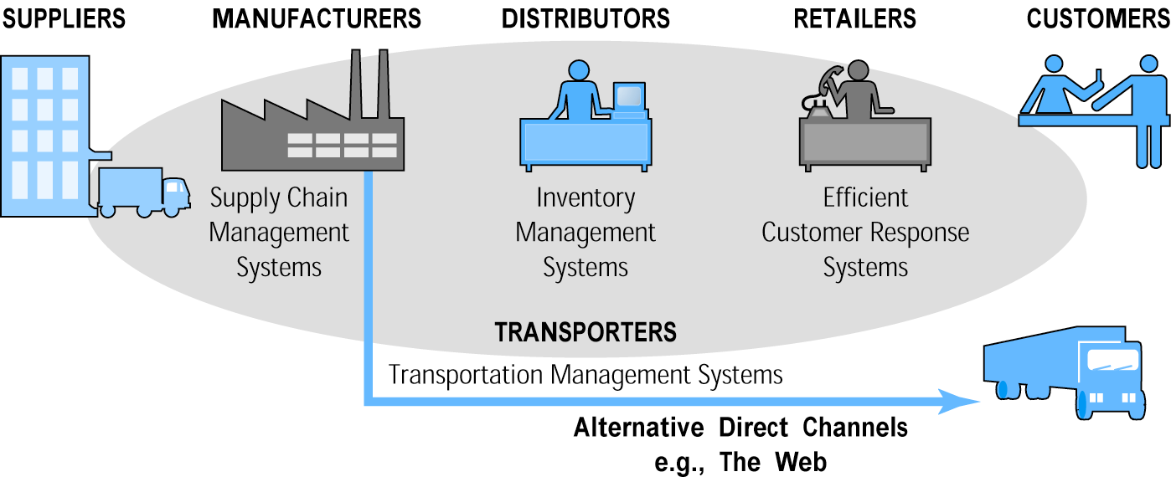
E-commerce and Industry Value Chains
Figure 2.5, Page 103

Slide 34
Firm Value Chains
Activities that a firm engages in to create final products from raw inputs
Each step adds value
Effect of Internet:
Increases operational efficiency
Enables product differentiation
Enables precise coordination of steps in chain

Slide 35
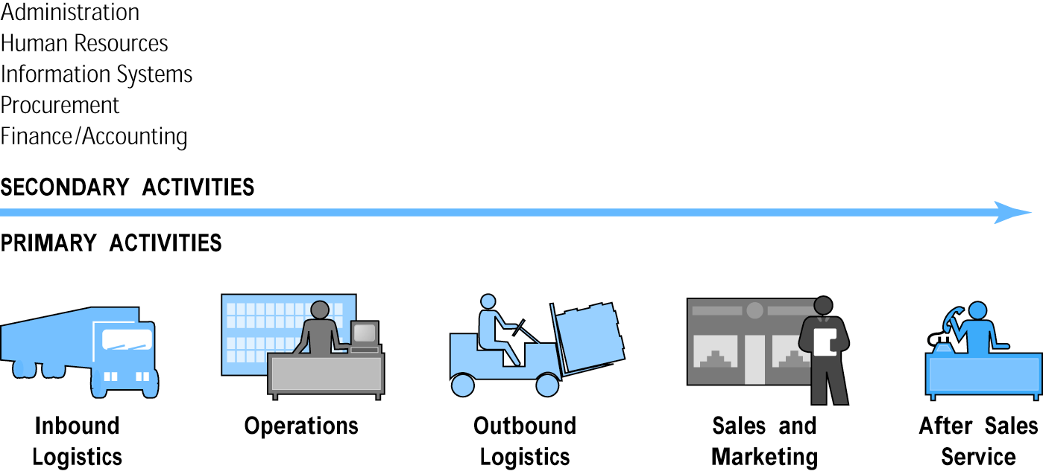
E-commerce and Firm Value Chains
Figure 2.6, Page 104

Slide 36
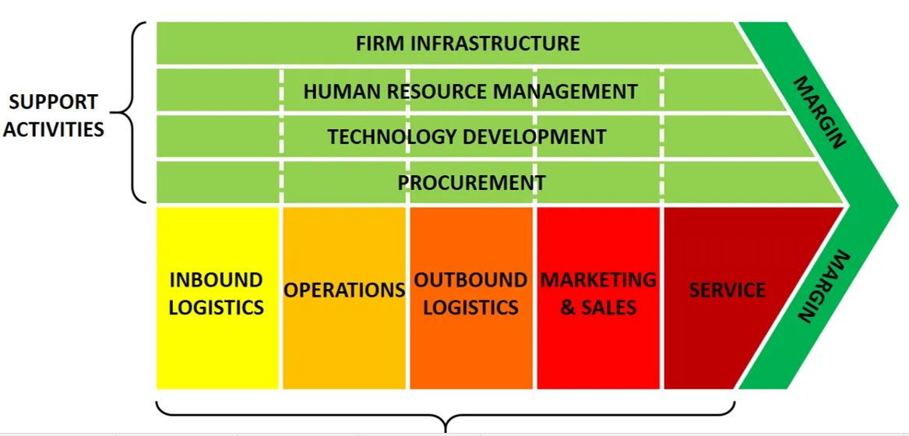
Firm Value Chain

Slide 37
Firm Value Webs
A value web is a collection of independent firms that use information technology to coordinate their value chains to produce a product or service for a market collectively.
Networked business ecosystem
Uses Internet technology to coordinate the value chains of business partners
Within an industry
Within a group of firms
Coordinates a firm’s suppliers with its own production needs using an Internet-based supply chain management system

Slide 38
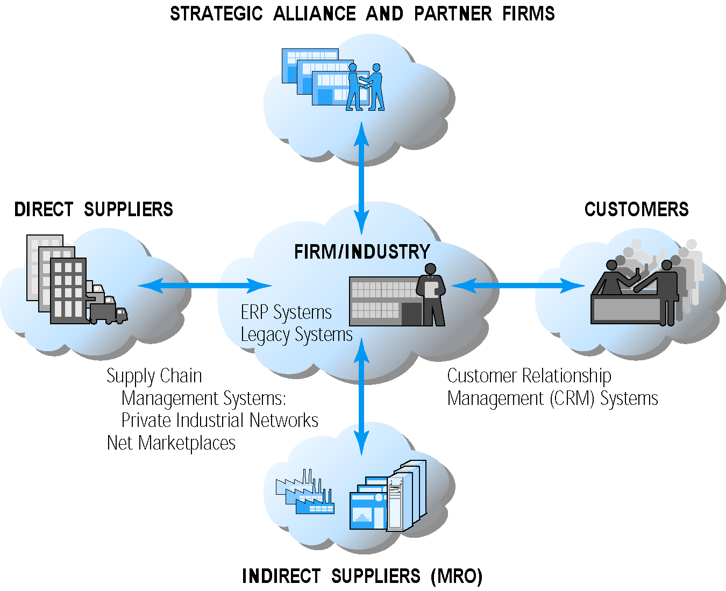
Internet-Enabled Value Web

Slide 39
Business Strategy
Plan for achieving superior long-term returns on the capital invested in a business firm
Four generic strategies
Differentiation
Cost
Scope
Focus

Slide 40
Differentiation
A strategy employed by businesses to increase the perceived value of their brand or products as a way to entice buyers to choose their products over similar products offered by their competitors. Differentiation can be achieved through competitive pricing, enhancements to functional design or features, distribution timing, expanded distribution channels, distributor location, brand reputation, product customization, and enhanced customer support.

Slide 41
Focus
A marketing strategy in which a company concentrates its resources on entering or expanding in a narrow market or industry segment. A focus strategy is usually employed where the company knows its segment and has products to competitively satisfy its needs. Focus strategy is one of three generic marketing strategies. See differentiation strategy and low cost strategy for the other two.

